Slide 1
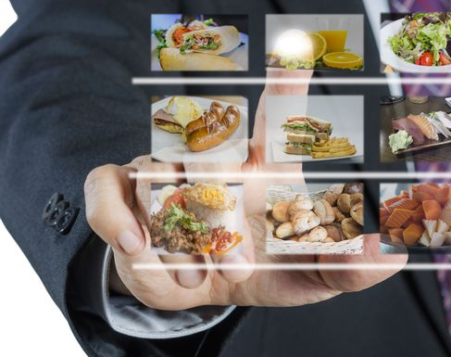
BIG DATA ANALYTICS FEATURING ZOMATO
IST 718 Project Presentation
Kartheek Sunkara | Rohit Menon Neel Samant | Shraddha Sawant Rashmitha Varma Pandati

Slide 2
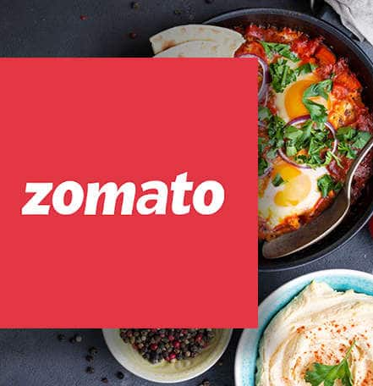


Slide 3
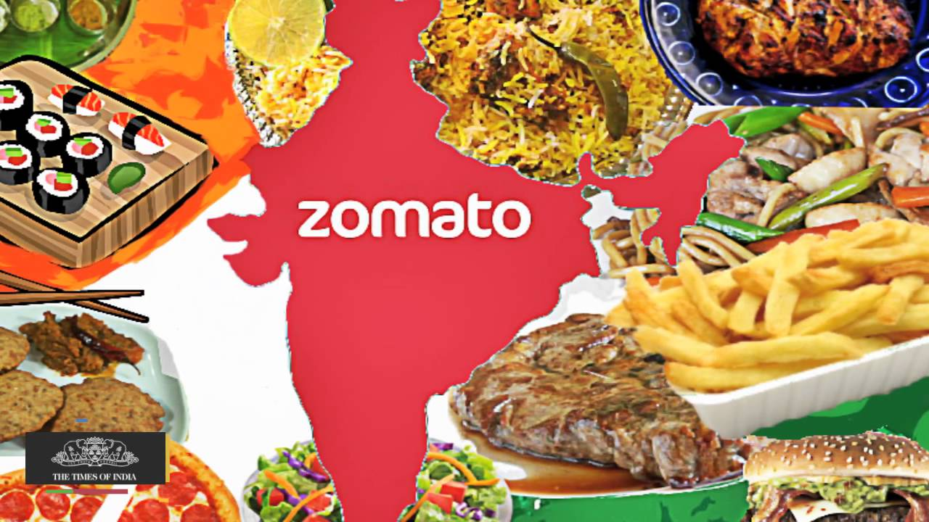

Slide 4
Problem Statement
Every human was, is, and will forever be excited about good food. But with the options that are existing in today's world it is very hard to choose where and what to eat because of various reasons like:
Cost
Location
Cuisine
Dine-in/Takeout/Delivery
Ratings and many more

Slide 5
Aim of our work
Our aim is to help people make better choices with Zomato as the medium
We developed the model majorly for three use case scenarios by three different users who are as follows:
Independent Restaurant Owners
Open new restaurants
Zomato
Increase partner base
Users of Zomato
Decide where and what to eat

Slide 6
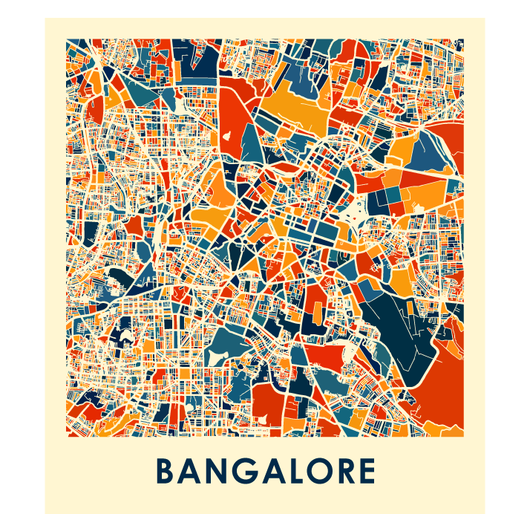
DATASET DESCRIPTION
The data available in the dataset has been recorded until 15th March, 2019
It has 56,250 rows and 17 columns
The 17 unique variables consists of URL, Address, Name, Online Order, Book Table, Rate, Votes, Phone, Location, Restaurant Type, Dish Liked, Cuisine, Approx Cost for Two, Review List, Menu, Type, City

Slide 7
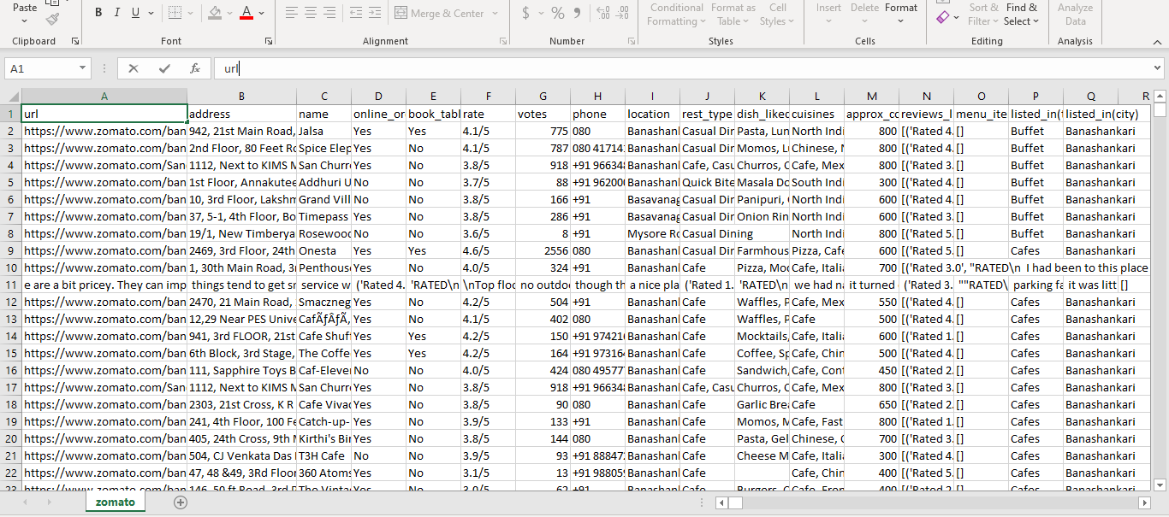
Zomato Dataset

Slide 8

Feature Engineering

Slide 9
Dropping unwanted column
URL and Phone Number
Votes, Approx Cost and Rating columns
Using Interpolation Method to fix null values
Location and Cuisine columns
Used mode to replace the missing values
Dish Liked and Restaurant Type columns
Filling Nan values with unknown to make it a separate category

Slide 10
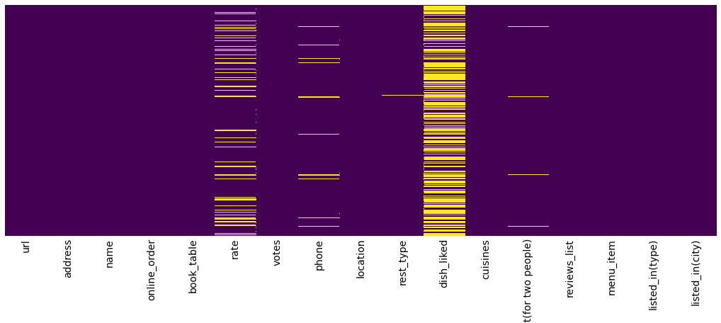
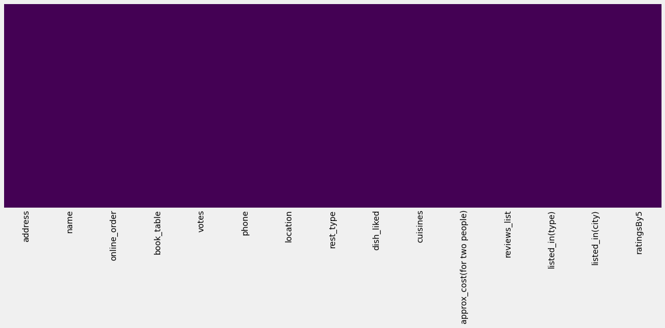
Before Data Cleaning
The yellow lines show the missing values in the respective columns of the dataset.
After Data Cleaning

Slide 11
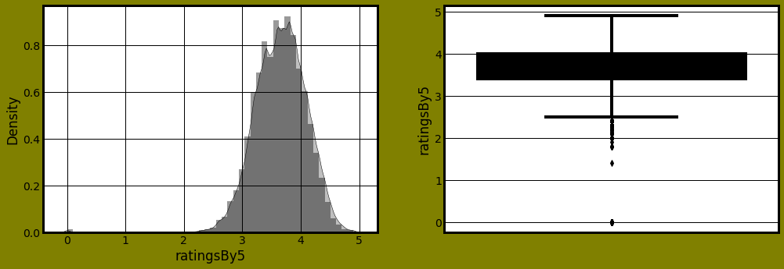
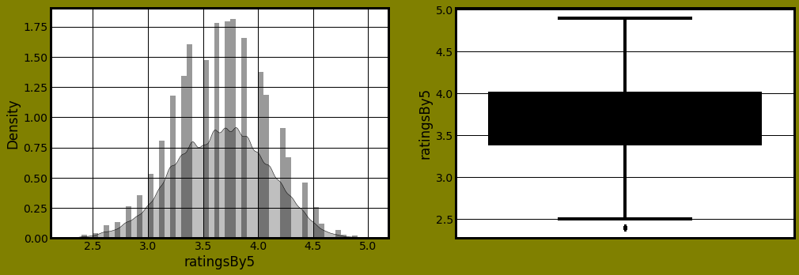
RATINGS
Before Removing Outliers
After Removing Outliers

Slide 12
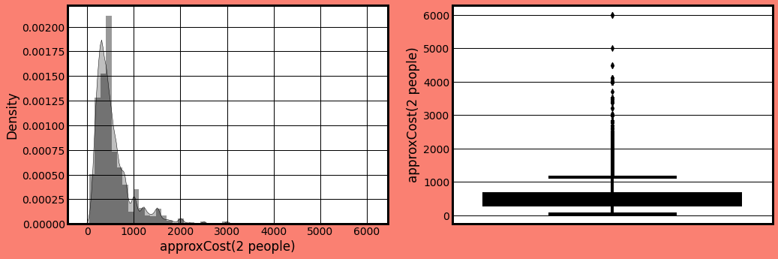
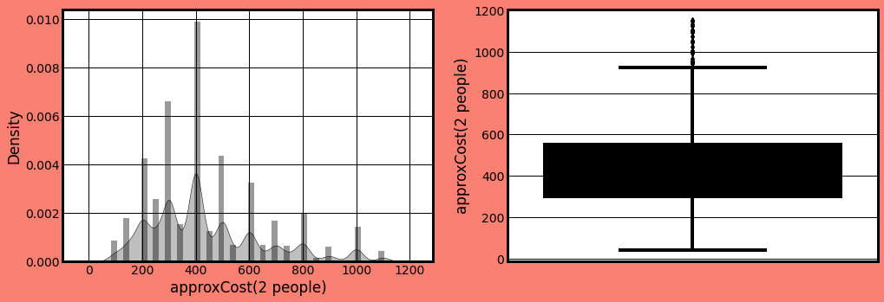
APPROXIMATE COST FOR 2 PEOPLE
Before Removing Outliers
After Removing Outliers

Slide 13
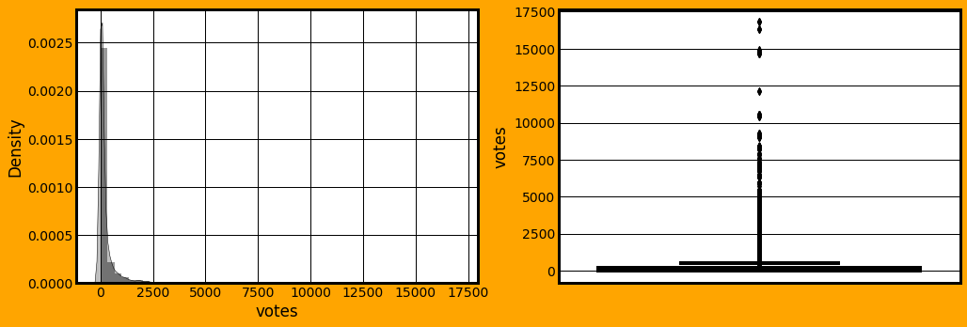
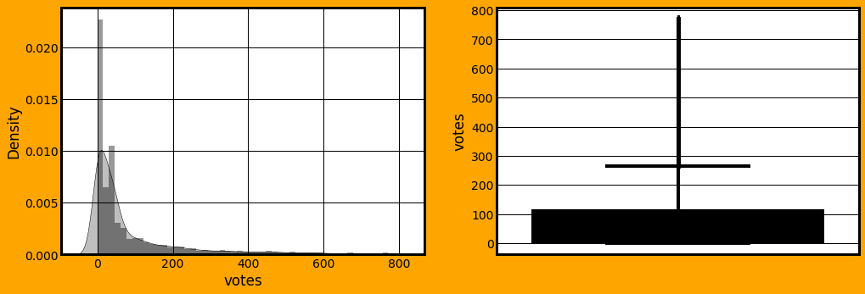
VOTES
Before Removing Outliers
After Removing Outliers

Slide 14
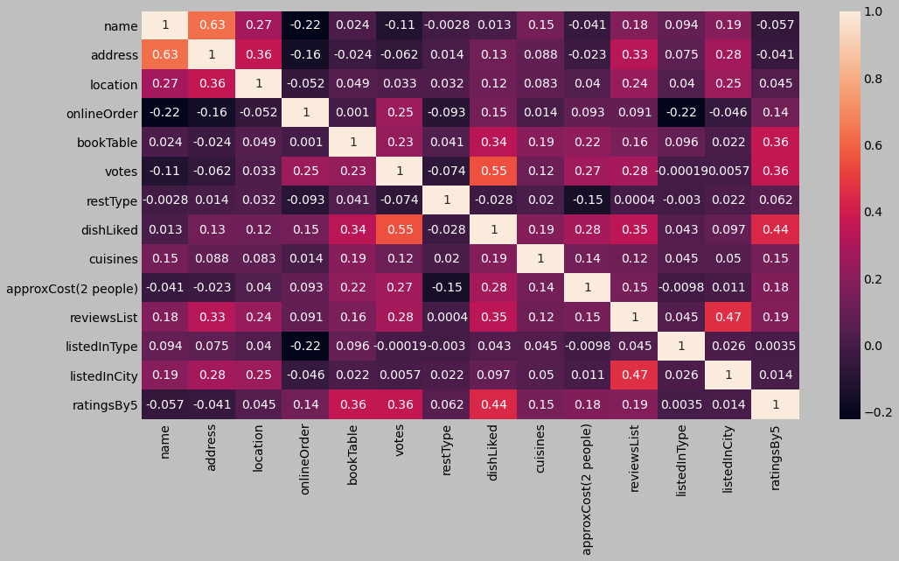

Slide 15

Exploratory Data Analysis

Slide 16
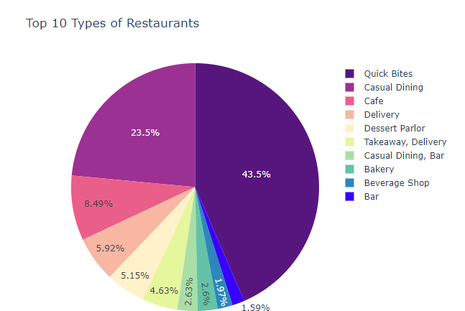
Top 10 Types of Restaurants in Bengaluru

Slide 17
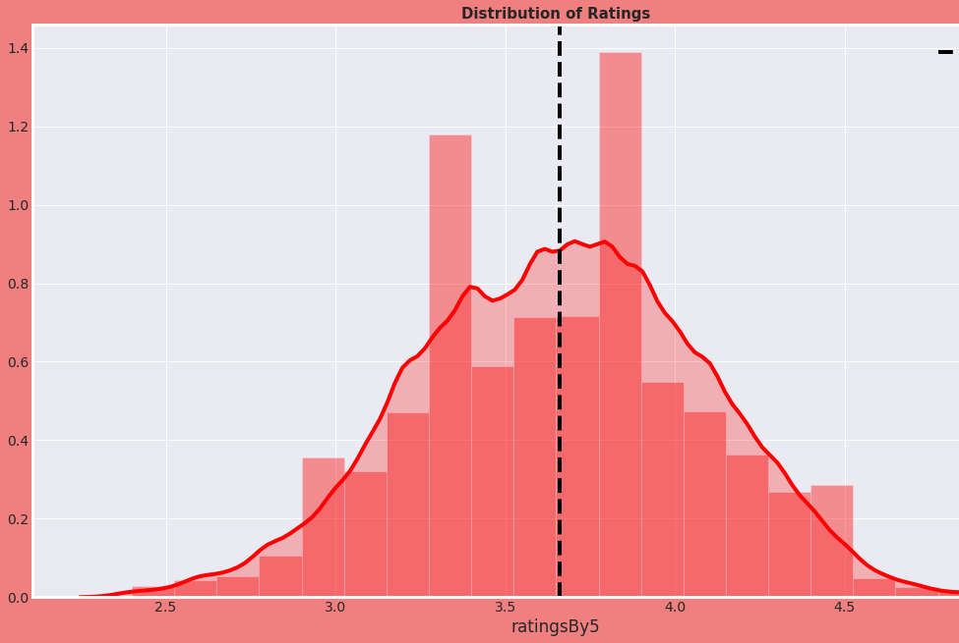
Distribution of Ratings of Restaurants in Bengaluru

Slide 18
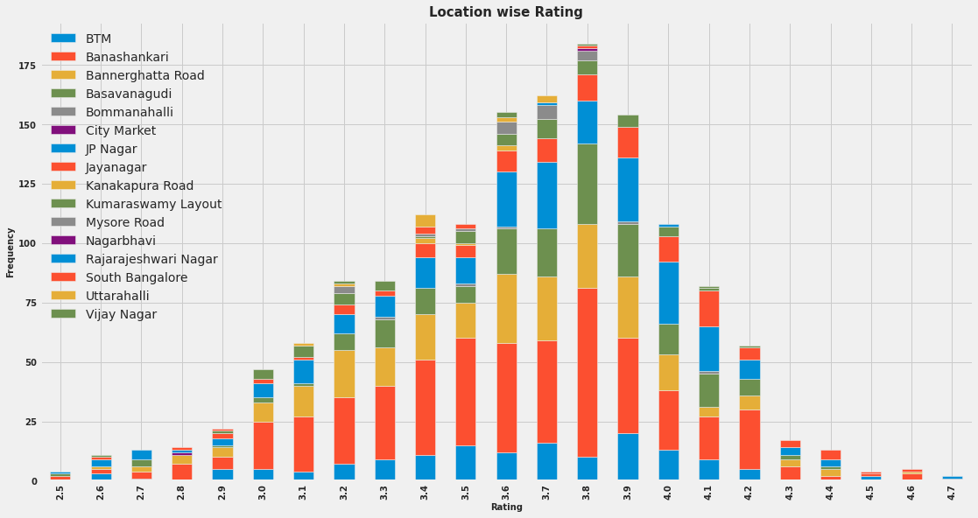
Rating with respect to Location

Slide 19
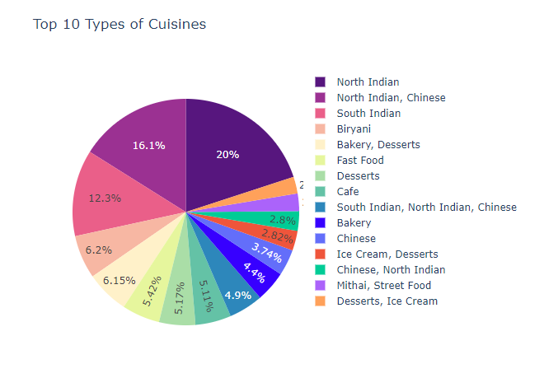
Top 10 Types of Cuisines in Bengaluru

Slide 20
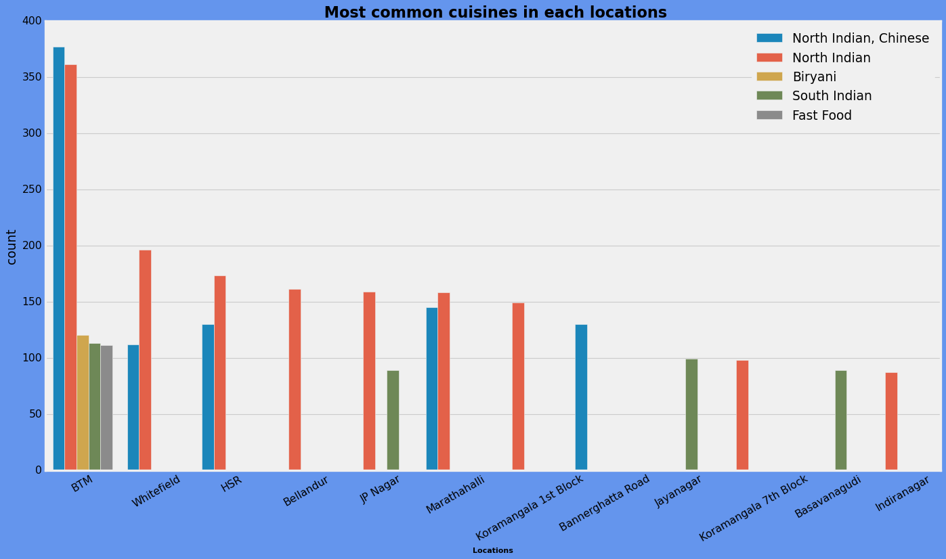
Most Common Cuisines with respect to locations

Slide 21
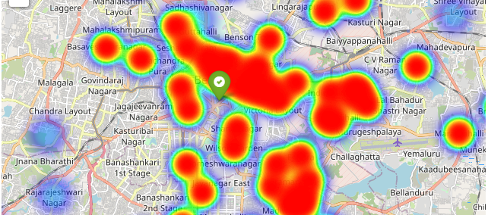
Find Location of nearby restaurants

Slide 22
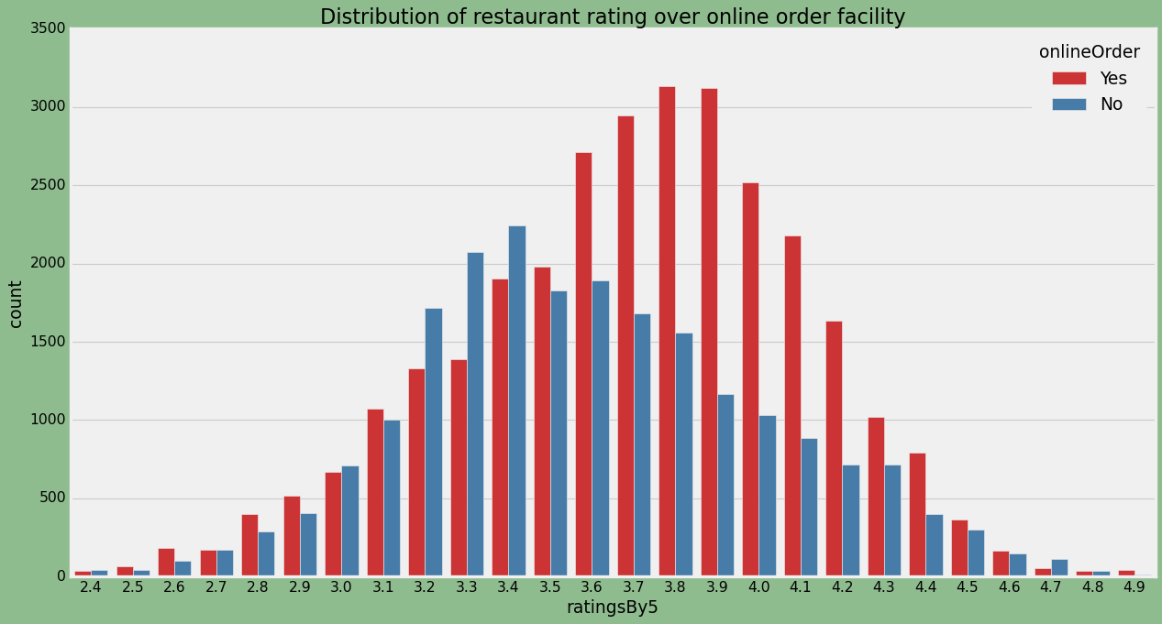
Distribution of Restaurant Rating based on online order facility

Slide 23
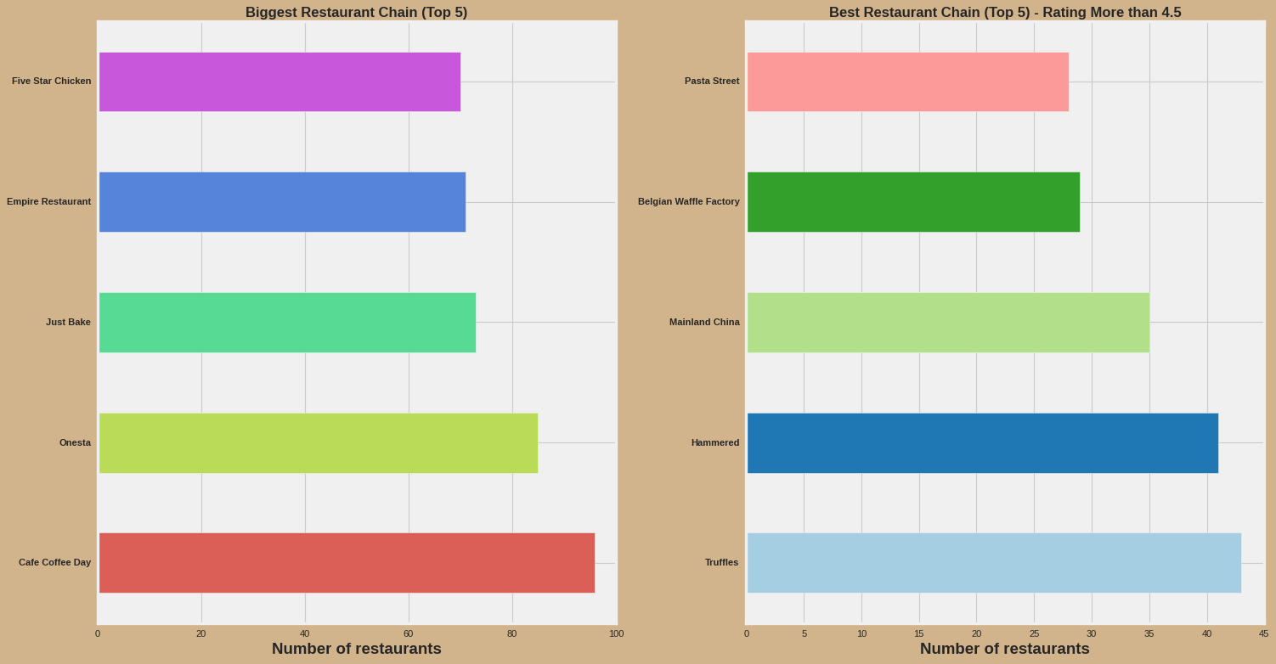
Biggest Restaurant Chain and Best Restaurant Chain in Bengaluru

Slide 24
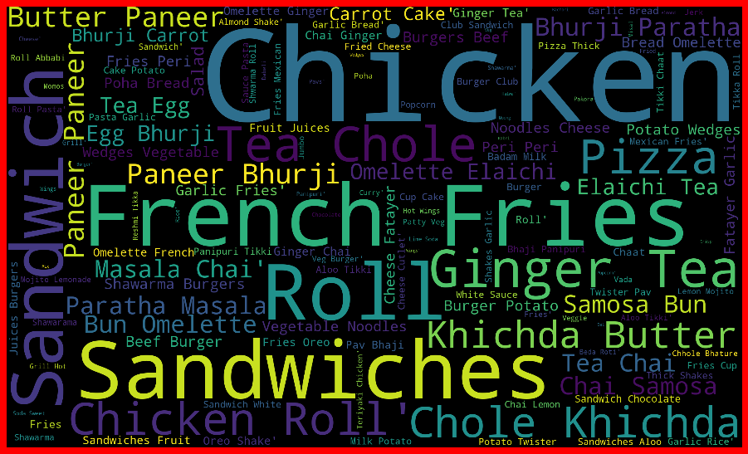
Dishes liked by Bangloreans in Fast Food Restaurants

Slide 25
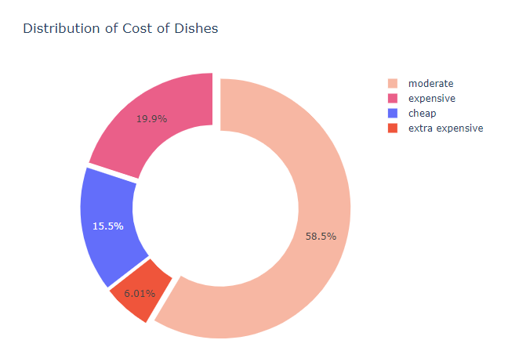
Distribution of Cost of Dishes

Slide 26

SPARK ML MODELS

Slide 27
Use Case 1 – Zomato online delivery service
PROBLEM: Zomato is always on the lookout on expanding its business because of increasing competition in the food delivery industry
SOLUTION: We used this dataset to help Zomato identify and target the potential restaurants that can use their services
METHODOLOGY: Using Random Forest Classifier Model

Slide 28
Random Forest Classifier
Data Source from the output of PCA
Columns sourced are restaurant type, votes, cuisines, location, ratingsBy5 and approximate cost for 2 people
Accuracy measurement using Binary Classification Evaluator
No. of trees => 20
Maximum tree depth => 5
Accuracy => 74.68%

Slide 29
Use Case 2 - Independent Restaurant Owners
PROBLEM: Independent restaurant owners have a hard time in deciding on their investment in opening a new restaurant
SOLUTION: We have used this dataset to predict the ratings of already established restaurants to help the independent restaurant owners to aid their decisions making process
METHODOLOGY: Using Linear Regression Model

Slide 30
Linear Regression Model
Data Source from the output of PCA
Columns sourced are restaurant type, votes, cuisines, location, online order and approx cost for 2 people
Accuracy measurement using mean squared error
Optimizer for cost function is SGD
Early stopping, split ratio of 0.8

Slide 31
Training, Testing & Co-efficients

Slide 32
Use Case 3 - Users of Zomato in Bengaluru
PROBLEM: Users on budget are often faced with confusion when choosing a restaurant to eat in Bengaluru because of its high prices
SOLUTION: We used this dataset to determine the Approximate Cost for 2 people in order to help the users in choosing a restaurant
METHOLOGY: Neural Network

Slide 33
Neural Network
We are predicting the approximate cost for 2 people at a restaurant
Feed Forward Neural Network as the relation between the target and the rest is not fully characterized
3 layers in total
Input: 7; Hidden: 9 ; Output: Regressor predictor
Stochastic Gradient Descent

Slide 34
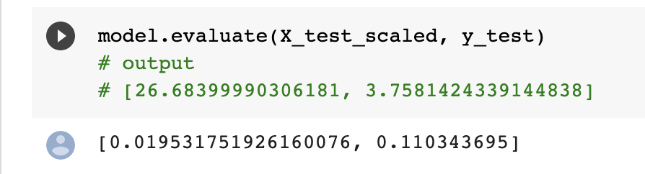
Output of training
Testing & Accuracy

Slide 35
Use Case 4 - Users of Zomato in Bengaluru
PROBLEM: Users new to a location looking for a place to eat are looking for suggestions for the same
SOLUTION: We used this dataset to provide a platform that serves as a recommendation engine to the users in a dilemma
METHOLOGY: Retrieval and Sort

Slide 36
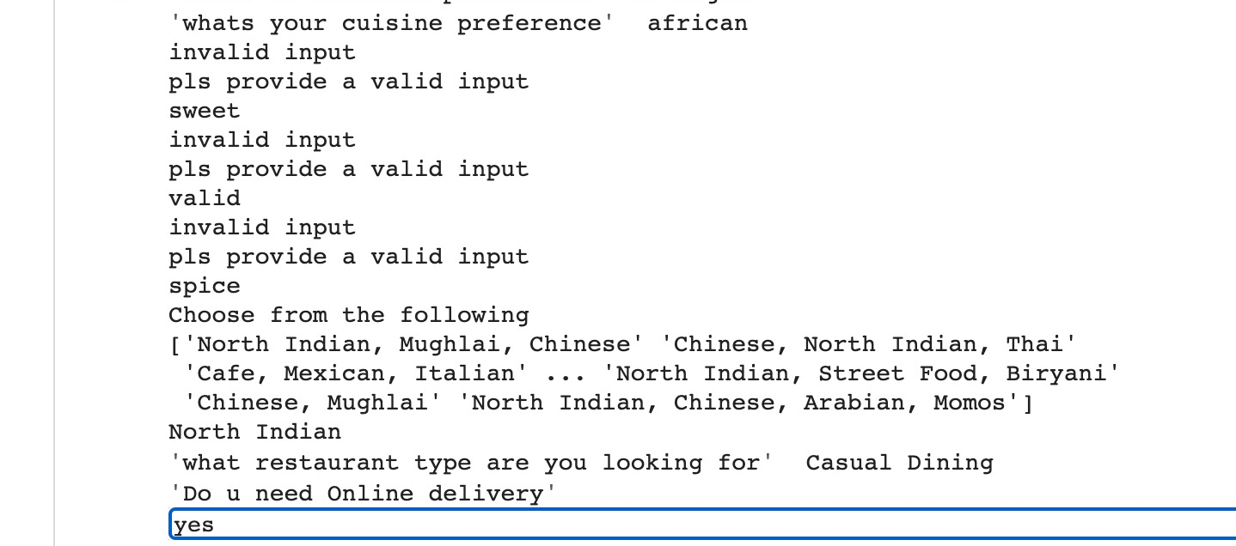
Retrieval and Sorting

Slide 37
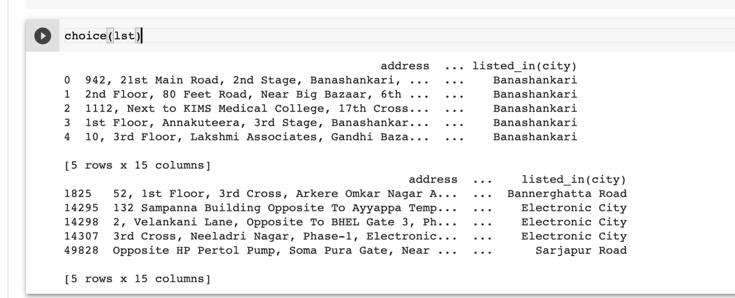
Retrieval and Sorting

Slide 38
RECOMMENDATIONS
Independent restaurant owner should use the factors- votes, location, online order services, booking table services, restaurant type, liked dishes and approximate cost for 2 people to improve their businesses or invest in a new one
Zomato should consider the restaurant type, location, approximate cost, votes, ratings and cuisines to decide who to approach to subscribe to their services
Users on budget can be assisted by providing an approximate cost for 2 people eating out derived from votes, cuisine, location, and ratingsby5 preferences

Slide 39


